Slide 1
Data Structures
10 Lecture – Binary Search Tree
  Inorder / preorder / postorder
  Binary Search Tree (BST)
  Creation of a BST
  Insertion a new item in a BST
  Traversing a Tree
  Searching an item into a BST
  Deletion of an item

Slide 2
Binary Search Tree(BST)
Is also a Binary Tree such that:
Every node entry has a unique key (i.e. no duplication item).
All the keys in the left subtree of a node are less than the key of the node.
All the keys in the right subtree of a node are greater than the key of the node.

Slide 3
Example 1:
key is an integer
43
31
64
20
40
56
89
28
33
47
59

Slide 4
Binary search tree construction algorithm:
Start with a tree containing just one Node (the root).
To add a new item, do the following until stop:
If item < root_item:
    If root_item has a left child then move to the left (root_item = root_item_left) and repeat.
    Else add a new left child with this item. Stop.
If item > root_item:
    If root_item has a right child then move to the right (root_item = root_item_right).
    Else add a new right child with this item. Stop.
Example : Make a BST with the following list.
5 9 8 1 2 4 6 10

Slide 5
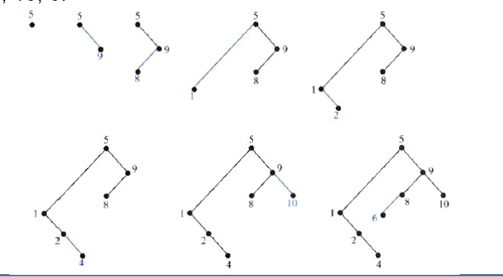
Example : Make a BST with the following list.
5 9 8 1 2 4 6 10

Slide 6
Exercises :
Construct a binary search tree for the words mathematics, physics, geography, zoology, meteorology, geology, psychology, and chemistry using alphabetical order.
Build a binary search tree for the words banana, peach, apple, pear, coconut, mango, and papaya using alphabetical order.
Dr. Kazi A Kalpoma

Slide 7
Insert a node into a BST (example)
57
43
31
64
20
40
56
89
28
33
47
59

Slide 8
Search: Checklist
if target key is less than current node’s key, search the left sub-tree.
else, if target key is greater than current node’s key, search the right sub-tree.
returns:
  if found, pointer to node containing target key.
  otherwise, NULL pointer.

Slide 9
Deleting a node in BST
As is common with many data structures, the hardest operation is deletion.
Once we have found the node to be deleted, we need to consider several possibilities.
  If the node is a leaf, it can be deleted immediately.
  If the node has one child, the node can be deleted after its parent adjusts a pointer to bypass the node and connect to inorder successor.
  The complicated case is when the node to be deleted has both left and right subtrees. The strategy is to replace the data of this node with the smallest data of the right subtree and recursively delete that node.

Slide 10
Example of BST
43
Two child
31
Two child
64
Two child
20
One child
Two child
One child
40
56
89
Leaf
28
33
Leaf
47
59
Leaf
Leaf
Leaf
Dr. Kazi A. Kalpoma

Slide 11
1. Deleted node 33 (node is a leaf)
43
31
64
20
40
56
89
28
33
Leaf node
47
59

Slide 12
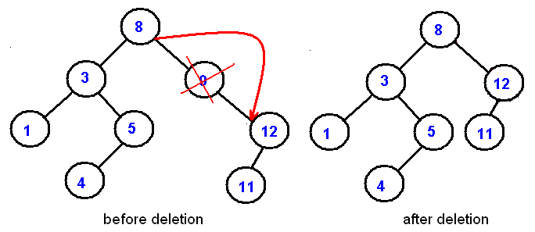
2. Deleted node 9 (node has one child)
this node can be deleted after its parent adjusts a pointer to bypass the node and connect to inorder successor.
(Inorder successor of a node is the next node in Inorder traversal of the Binary Tree.)

Slide 13
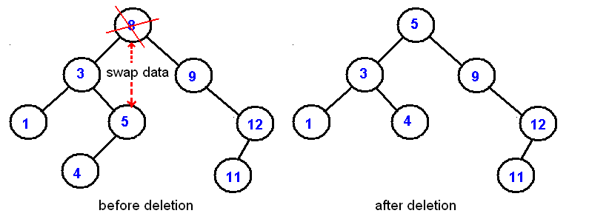
3. Deleted node 8 (node has both left and right subtrees)
The strategy is to replace the data of this node with the smallest/largest data of the right/left subtree and recursively delete that node.
and delete this node

Slide 14
Data type of a Tree Node
struct treenode
{
int data;
struct treenode *left, *right;
};
struct treenode *root, *ptr;
void make_root(int x);
void make_node(int x);
void inorder(treenode *p);

Slide 15
main() Function for BST creation
int main()
{
root=NULL;
int x;
while(1)
{ cout<<"Enter data or 0 for exit: ";
cin>>x;
if(x==0) break;
else
{ if(root==NULL)
{ make_root(x);}
else
{ make_node(x);}
}
}
inorder(root);//to display the tree
return 0;
}

Slide 16
void make_root(int x)
{ root=new treenode; root->data=x; root->left=NULL; root->right=NULL;
}
Make_root() Function for root creation

Slide 17
void make_node(int x)
{ struct treenode *np = new treenode; np->data=x; np->left=NULL; np->right=NULL; ptr=root; while(ptr!=NULL)
{ if(ptr->data==x) break; else if (ptr->data>x)
{ if(ptr->left==NULL)//if left child NULL then link node as left child
{ ptr->left=np; break; } else ptr=ptr->left; //move left
} else if (ptr->data<x)
{ if(ptr->right==NULL) // if right child NULL then link node as right child
{ ptr->right=np; break;} else ptr=ptr->right; //move right }
}
}
Make_node() Function for other node creation
cout<< "Duplicate data\nEnter data again ";
cin>>x;//new data to avoid duplicate one
np->data=x;
ptr=root;//start again from root data

Slide 18
main() Function for BST creation
int main()
{
root=NULL;
create();
inorder(root);//to display the tree
insert();
int item;
cout<<"\nEnter item want to search:"; cin>>item;
search(item); //function will return a pointer
return 0;
}

Slide 19
void insert()
{ int x; cout<<"Enter data want to insert:"; cin>>x; make_node(x); cout<<“After insertion ”<<x<<endl; inorder(root);//to display the tree
}
insert() Function for insertion a node

Slide 20
search(int item) //use void for non-returnable function
{ struct treenode *p; p=root; while(p!=NULL)
{ if(p->data==item){cout<<"Found \n"; break;} else if(p->data>item)
{ if(p->left==NULL)
{cout<<"Not found \n"; break; } else { p=p->left; }
} else if(p->data<item)
{ if(p->right==NULL)
{cout<<"Not found \n"; break; } else { p=p->right; }
}
}
}
search() Function for searching a node

Slide 21
Postorder Traversal (recursive version)
A B / C * D * E +
void postorder(TreeNode *ptr)
{
if (ptr!=NULL) {
postorder(ptr->left);
postdorder(ptr->right);
cout << ptr->data;
}
}
+
*
E
*
D
/
C
A
B

Slide 22
Inorder Traversal (recursive version)
A / B * C * D + E
void inorder(TreeNode *ptr)
{
if (ptr!=NULL) {
inorder(ptr->left);
cout << ptr->data;
indorder(ptr->right);
}
}
+
*
E
*
D
/
C
A
B

